Slide 1





STREREO AUDIO AMPLIFIER
SUPERVISER: DR SAID EMAM

Slide 2





our team
said khalid
Gehad Amr
Rahma Mostafa
Eman Mohamed

Slide 3



TOPICS
1
introduction
2
stages of implementation
3
video for illustration

Slide 4
INTRODUCTION
Every great journey starts with great milestone by me
We started our work by searching for what is the a stereo amplifier and a what suitable ics we can use.
The outcome was that we selected ( TDA2822 & LM386) to further test
Starting with the TDA2822 and after some ideas we started creating the schematic for the circuit and we where faced with the first challenge: there is no simulation option for the ic in proteuos !!
After doing some digging and searching and even trying to find a spice model we couldn’t make it work.
And so we decided to trust our skills and rely on trial and error to get
Data like any hardcore Engineer.

Slide 5
STAGES OF IMPLEMENTATION
breadboard test
1
searching
3
2
simulation
4
pcb layout
5
finishing

Slide 6
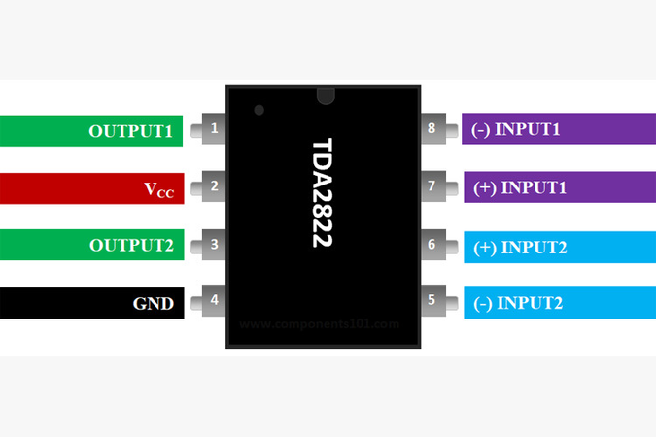
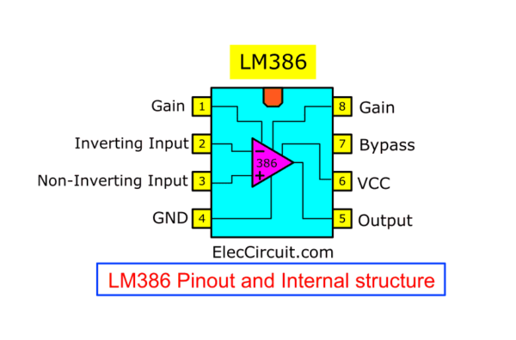
SEARCHING

Slide 7
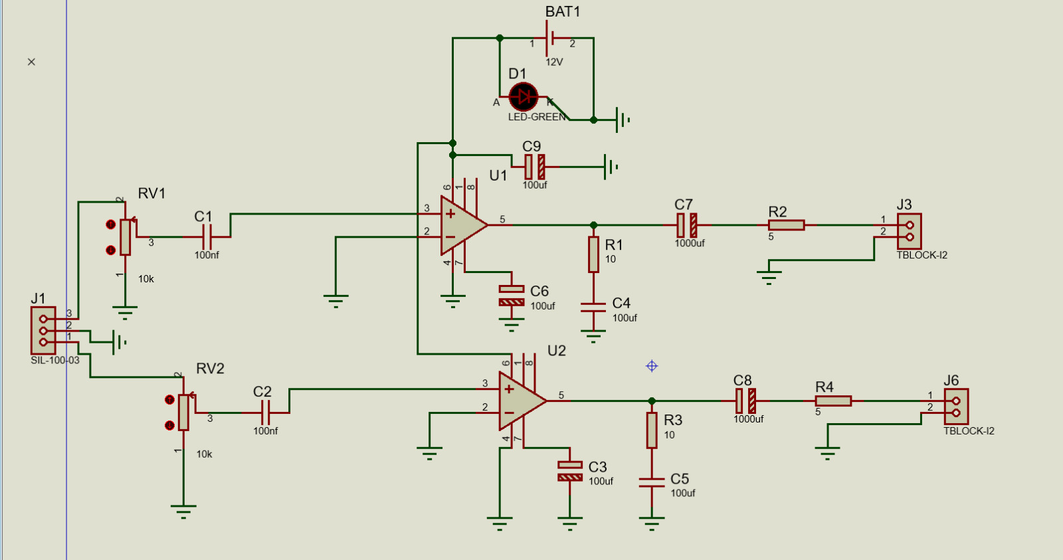
SIMULATION

Slide 8
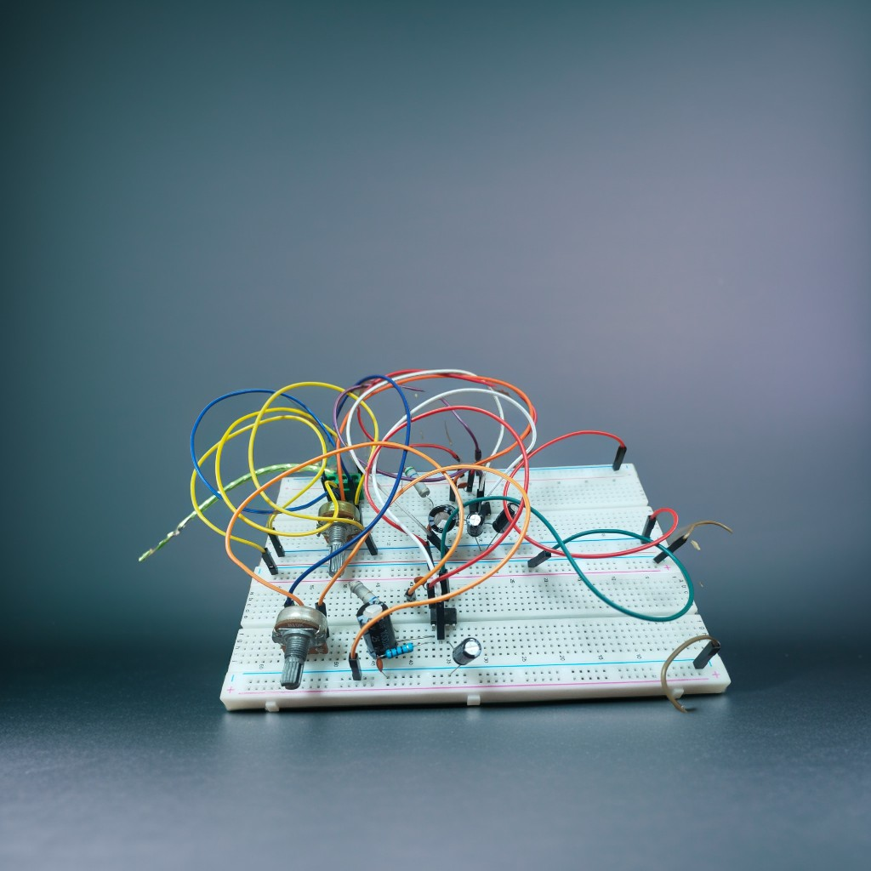
BREADBOARD

Slide 9
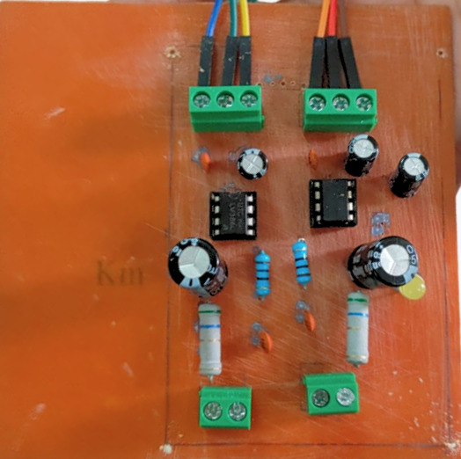
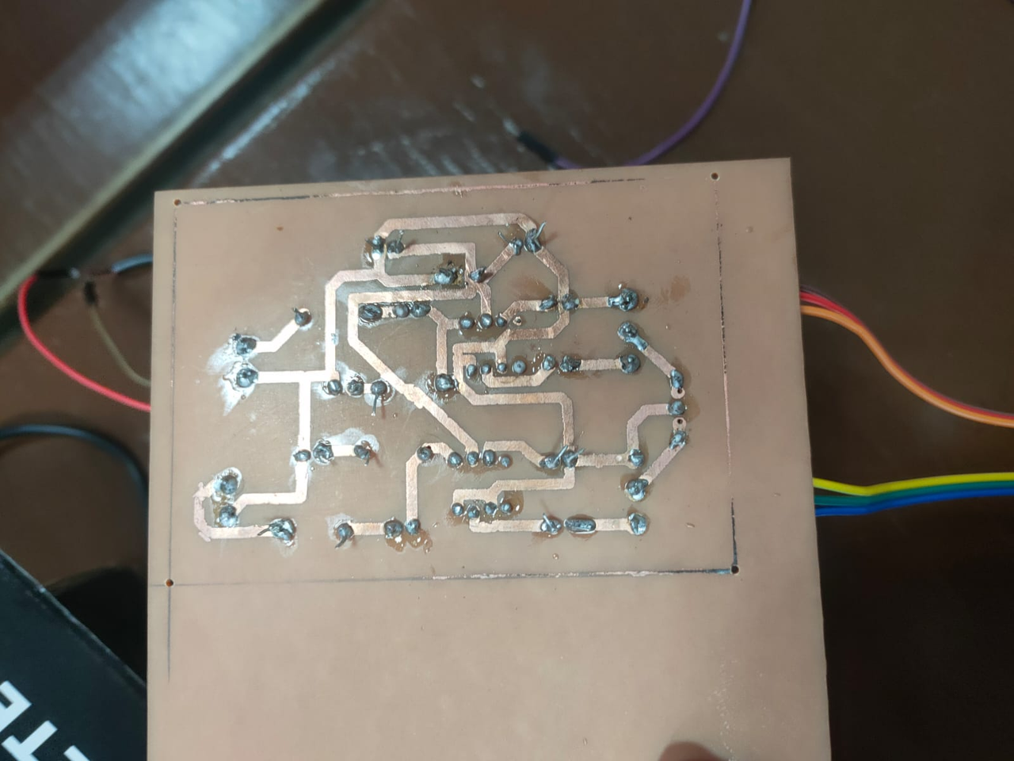
PCB LAYOUT

Slide 10
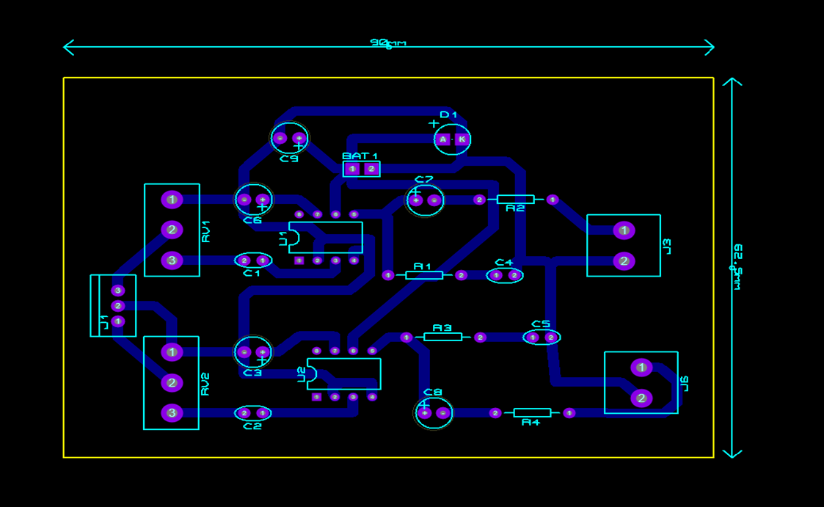
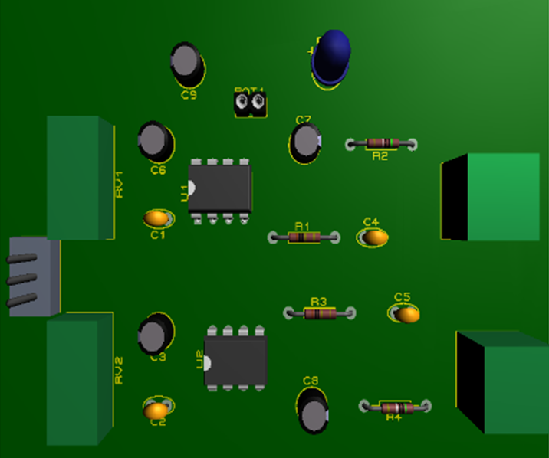
PCB LAYOUT

Slide 11
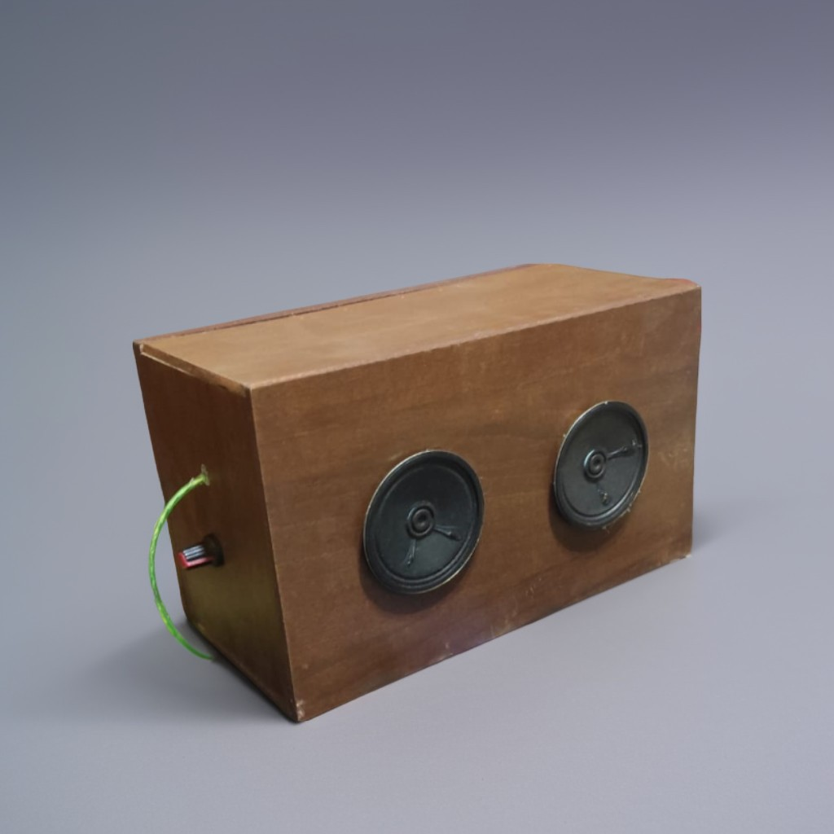
FINISHING

Slide 12
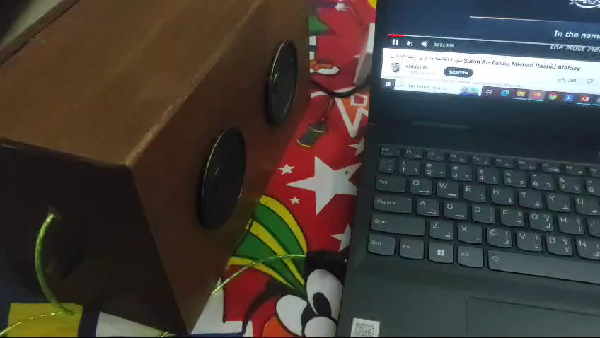
VIDEO FOR ILLUSTRATION

Slide 13

The ultimate alliance
We all face challenges and hardships so having friends can help overcome any challenges and that’s what happened in creating the pcb
We along with other teams (group 3,4 & 13) have gathered and shared our resources efforts and knowledge to finish each one of our pcbs with the least possible damage.

Slide 14

THANK YOU
Presented by : group 7

